Slide 1
Statewide Survey on Broadband Adoption 2023 Internet Adoption and the “Digital Divide” in California
Results from a Survey Conducted for the California Department of Technology (CDT) and the California Emerging Technology Fund (CETF)
Principal Investigators:
Dr. Hernan Galperin, Dr. François Bar & Dr. Thai V. Le
University of Southern California
January 2024

Slide 2
About the Statewide Survey on Adoption
Population: California Adults (Age 18 and Older)
Method of Collection: Multimodal (RDD + Text-to-Web)
Languages: English, Spanish, Mandarin, Vietnamese
Margin of Error: <3% for 95% Confidence Level
Fieldwork Dates: February – June 2023
Sampling: Main Sample + 3 Oversamples

Slide 3
Sampling Strategy and Sample Size
Sample Type | Description | Amount | Total
Main Sample | Telephone Surveys Complete | 1,000 | 1,899
 | Telephone Surveys Basic | 249
 | Online Text-to-Web | 650
Oversample | Rural County Regions | 1,059 | 1,661
 | Low-Income HHs (Pre-Paid) | 283
 | Department of Rehabilitation | 319
TOTAL |  |  | 3,560

Slide 4
Main Topics
Adoption Across Covered Populations and Regions
Broadband Costs
Reasons for Non-Adoption
ACP Awareness and Participation
Telehealth
Access and Devices Among K-12 Households
Digital Skills

Slide 5
Key Concept Definitions
Connectivity
Self-reported
Residential connectivity (“at home”)
Any technology, either fixed or mobile
Connected vs. unconnected: based on residential access
“Underconnected”: has mobile access only

Slide 6
Key Concept Definitions
Covered populations (as defined by Infrastructure Act):
Low-income HHs (below at or below 150% of FPL)
Aging individuals (60+ years)
Veterans
Individuals with disabilities
Individuals with a language barrier
Members of a racial or ethnic minority group
Individuals who primarily reside in a rural area
Women
LGBTQIA+
Incarcerated individuals

Slide 7
Main Topics
Adoption Across Covered Populations and Regions
Broadband Costs
Reasons for Non-Adoption
ACP Awareness and Participation
Telehealth
Access and Devices Among K-12 Households
Digital Skills

Slide 8
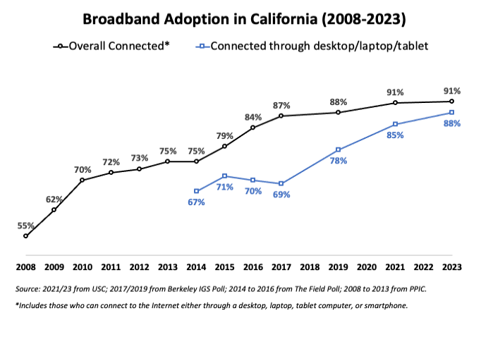
Broadband Adoption Remains High While Share of Underconnected (Smartphone-Only) Continues to Drop
Smartphone-only

Slide 9
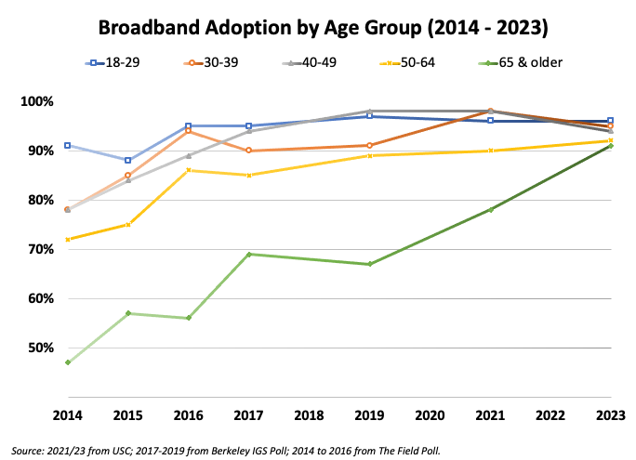
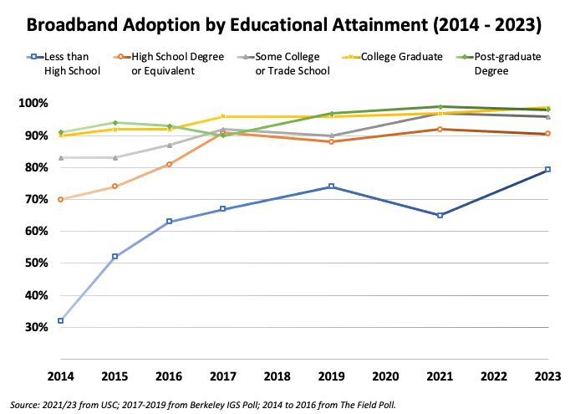
Adoption Gaps for Several Covered Populations and Disadvantaged Groups Are Closing

Slide 10
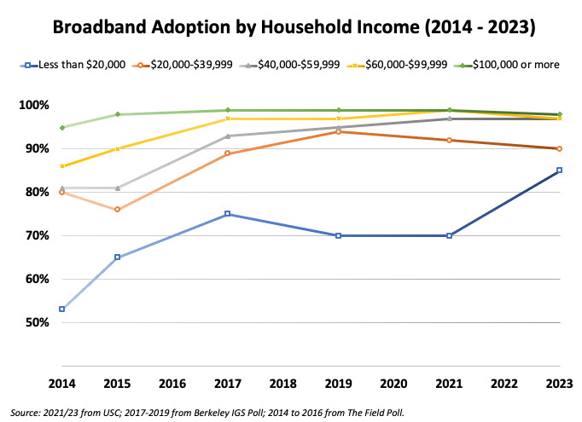
Income Gap in Broadband Adoption Has Decreased Thanks to Jump in Adoption Among the Poorest Households (<20K)

Slide 11
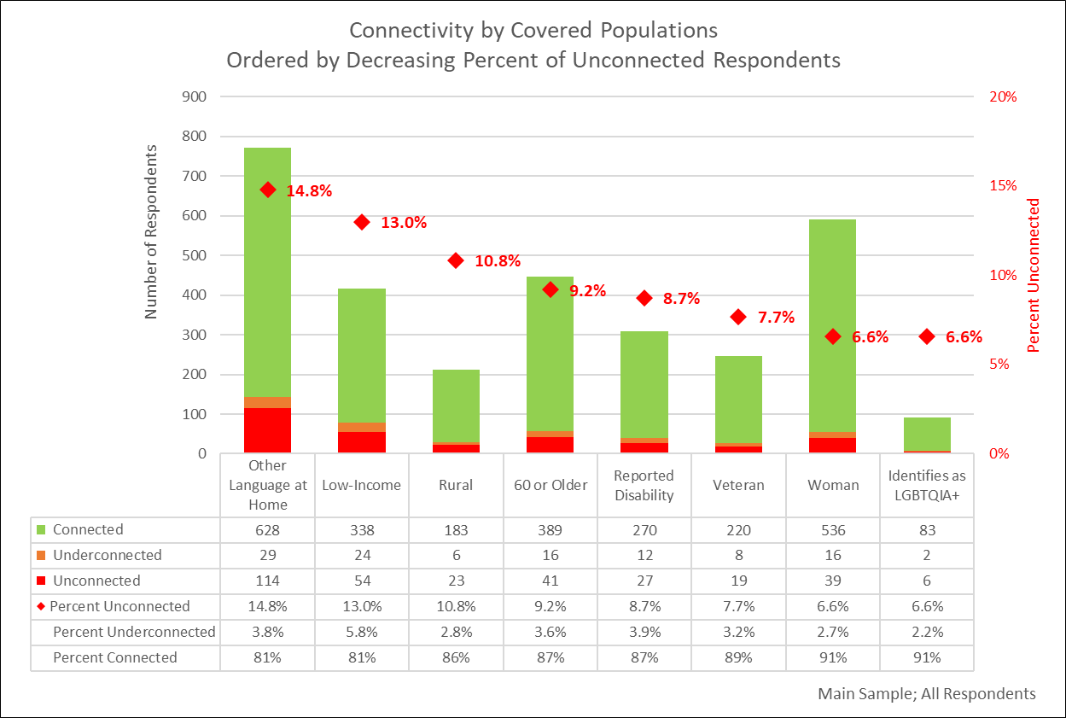
Covered Populations: Low-Income and Households with Language Barriers Still Lag Behind in Broadband Adoption

Slide 12
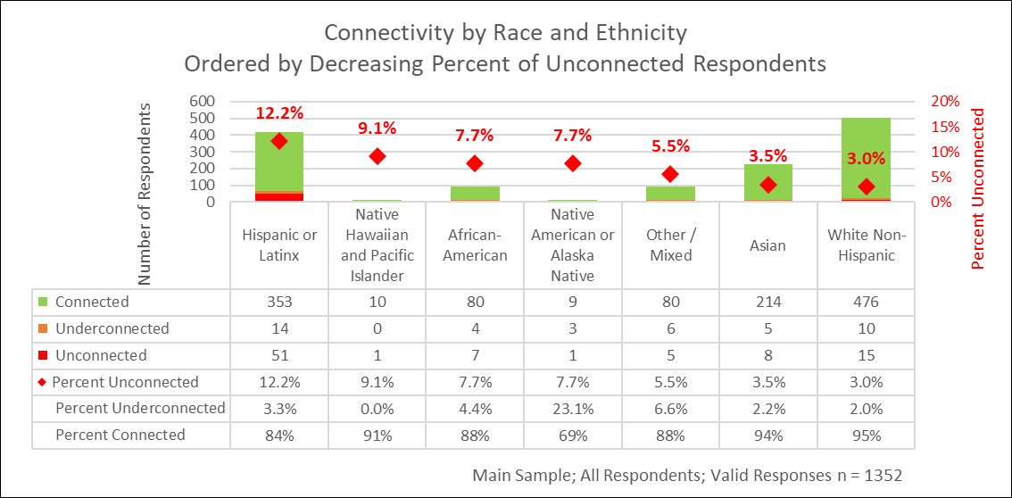
Hispanic/Latinx Residents More Likely to be Unconnected Than Other Racial/Ethnic Groups

Slide 13
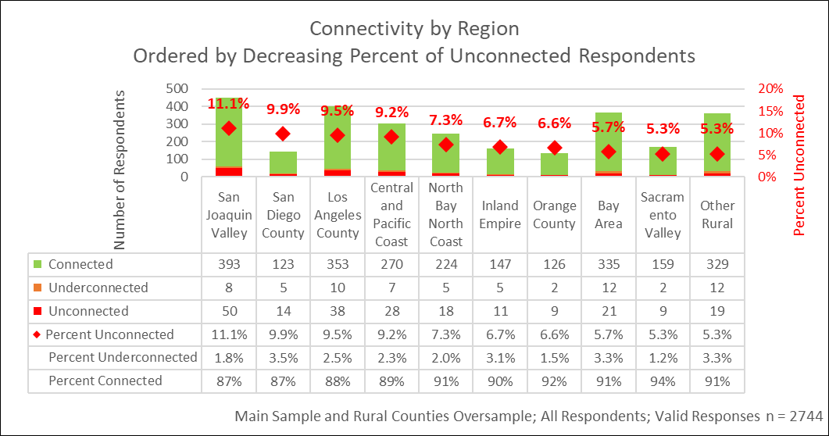
Main + Rural Oversample: Broadband Adoption Varies Across the State, San Joaquin Valley Lags Behind Other Regions

Slide 14
Main Topics
Adoption Across Covered Populations and Regions
Broadband Costs
Reasons for Non-Adoption
ACP Awareness and Participation
Telehealth
Access and Devices Among K-12 Households
Digital Skills

Slide 15
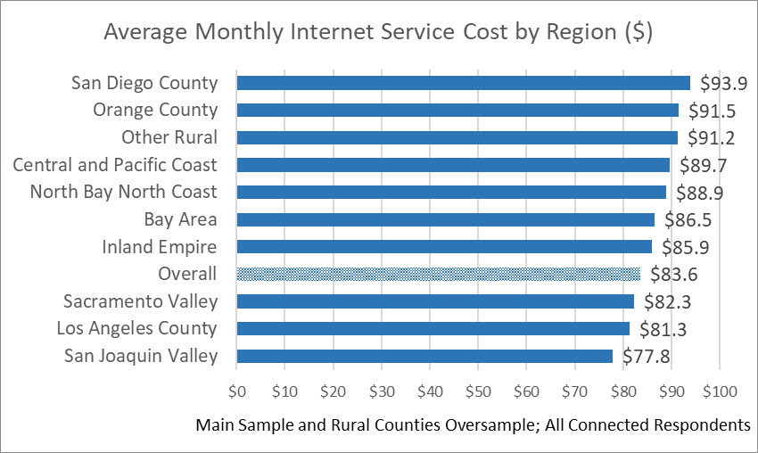
Average Cost of Broadband in California is $83.60/month, Generally Higher in Rural Areas

Slide 16
Main Topics
Adoption Across Covered Populations and Regions
Broadband Costs
Reasons for Non-Adoption
ACP Awareness and Participation
Telehealth
Access and Devices Among K-12 Households
Digital Skills

Slide 17
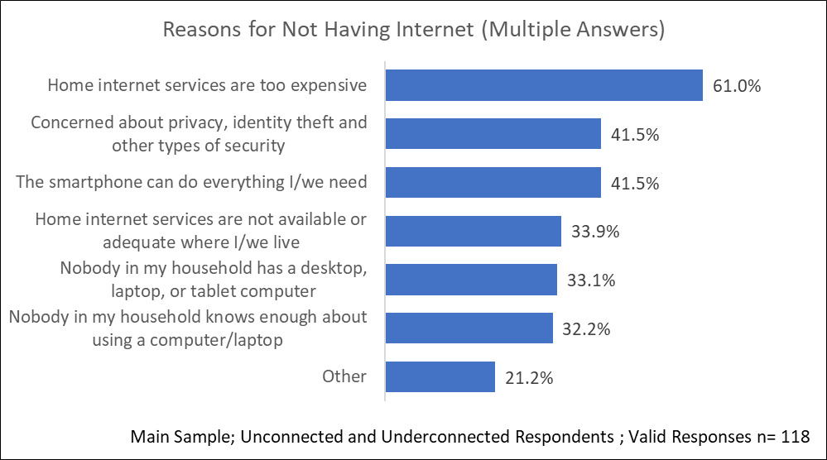
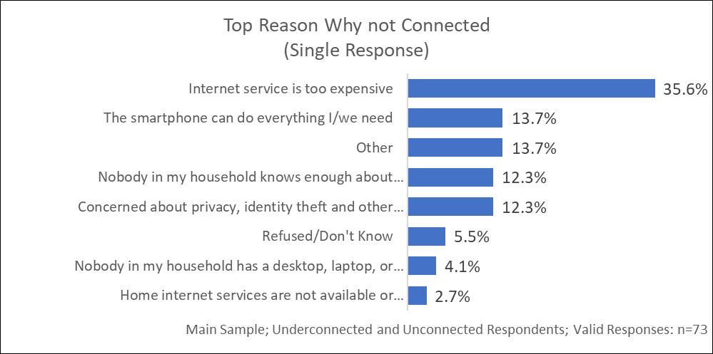
Cost Is the Main Barrier to Broadband Adoption, Followed by Concerns About Privacy

Slide 18
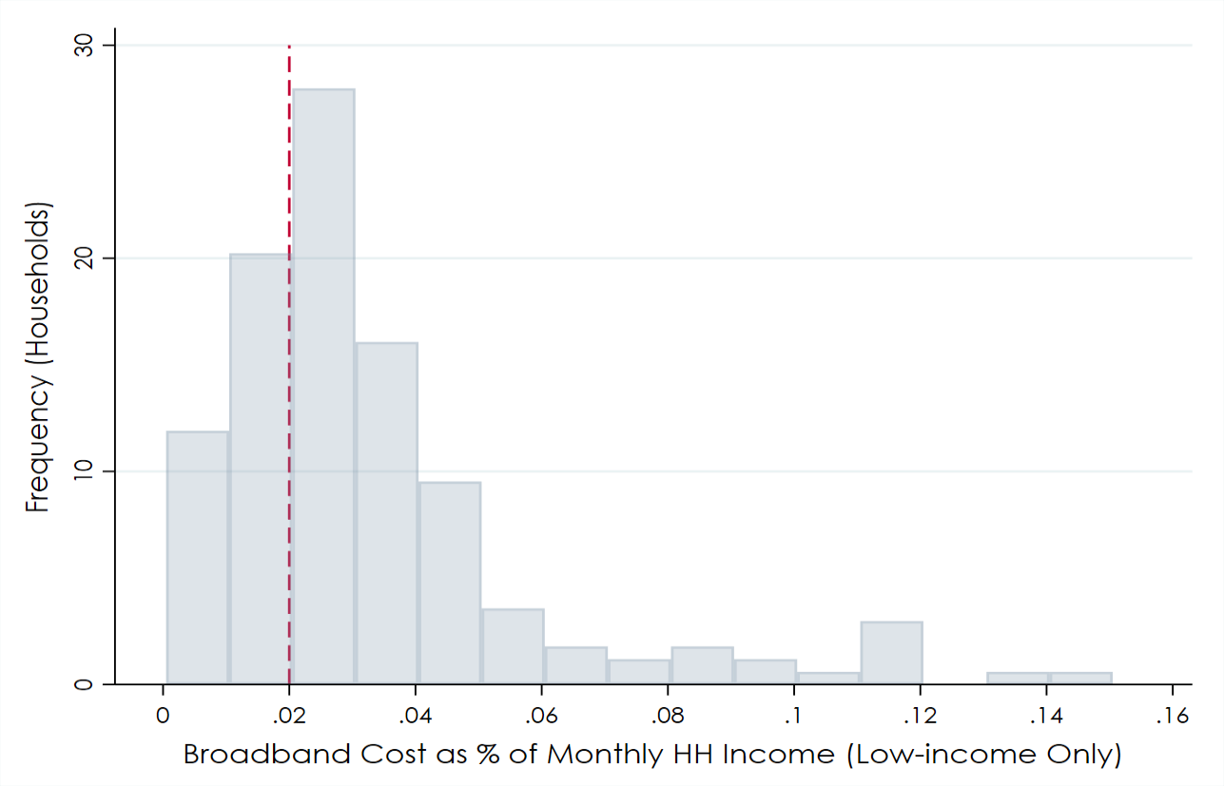
For Most Low-income Households (~70%), Cost Exceeds FCC-Recommended Threshold (2% of Disposable Income)

Slide 19
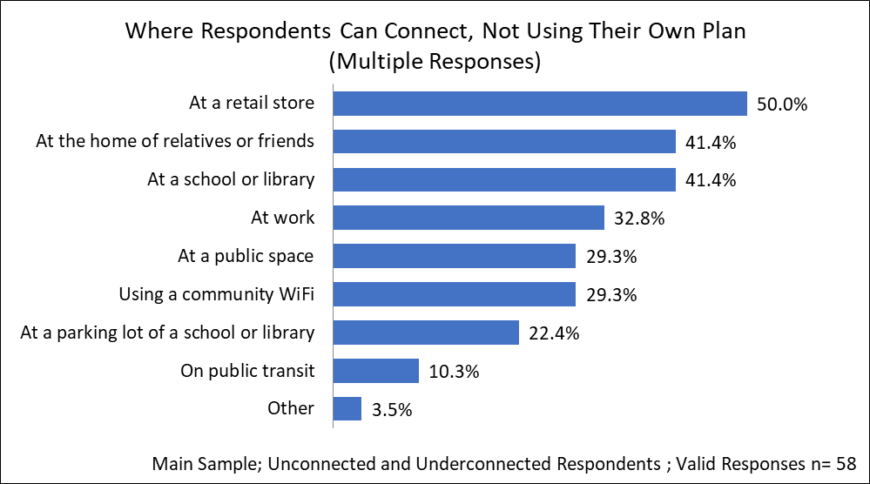
Public/Community Broadband Remains a Key Access Alternative for Unconnected Households

Slide 20
Main Topics
Adoption Across Covered Populations and Regions
Broadband Costs
Reasons for Non-Adoption
ACP Awareness and Participation
Telehealth
Access and Devices Among K-12 Households
Digital Skills

Slide 21
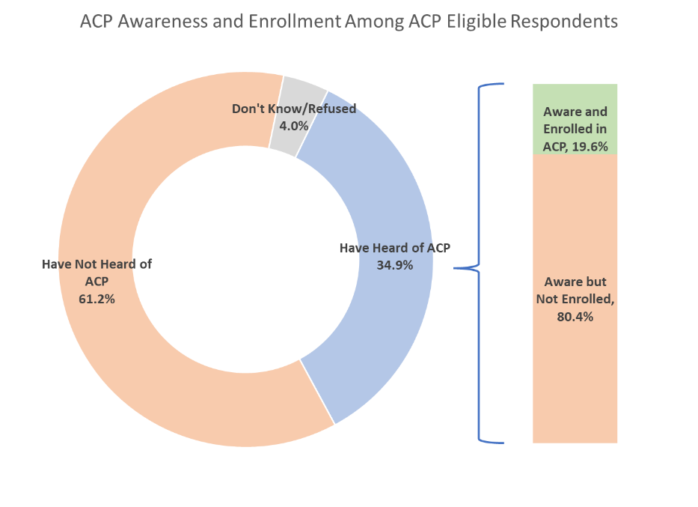
ACP Awareness and Participation Rates Remain Low Among Eligible Households

Slide 22
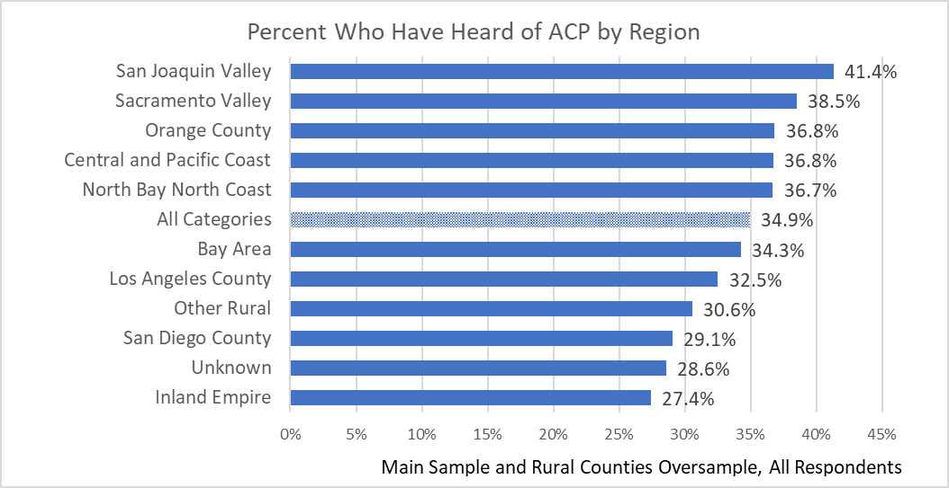
ACP Awareness Varies Across the State, Higher in San Joaquin/Sacramento Valley, Lower in Inland Empire

Slide 23
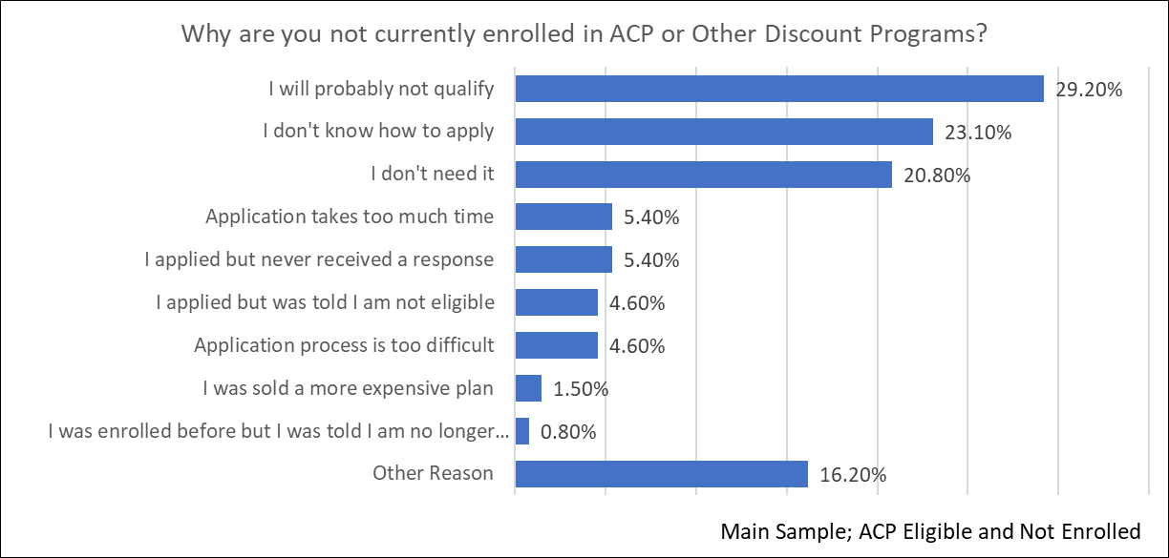
Beyond Awareness, Lack of Information/Misinformation Also Reduce Participation in ACP and Similar Programs

Slide 24
Main Topics
Adoption Across Covered Populations and Regions
Broadband Costs
Reasons for Non-Adoption
ACP Awareness and Participation
Telehealth
Access and Devices Among K-12 Households
Digital Skills

Slide 25
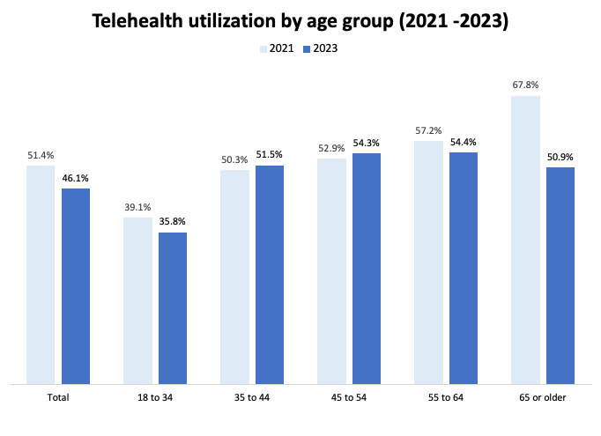
Following Pandemic Surge, Telehealth Utilization Has Declined in Particular for Older Adults

Slide 26
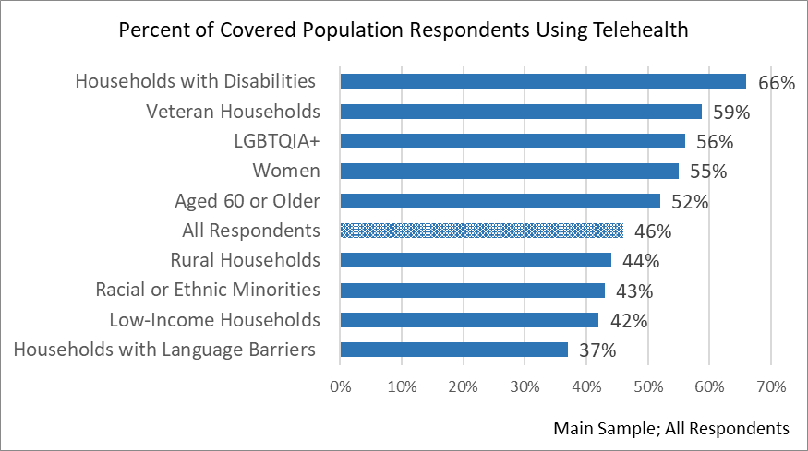
Telehealth Utilization Lower for Those With Language Barriers and Low-Income Households

Slide 27
Main Topics
Adoption Across Covered Populations and Regions
Broadband Costs
Reasons for Non-Adoption
ACP Awareness and Participation
Telehealth
Access and Devices Among K-12 Households
Digital Skills

Slide 28
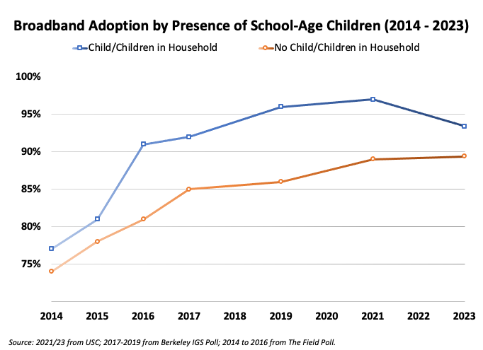
Broadband Adoption Among K-12 Households Has Decreased to Just Below Pre-Pandemic Levels

Slide 29
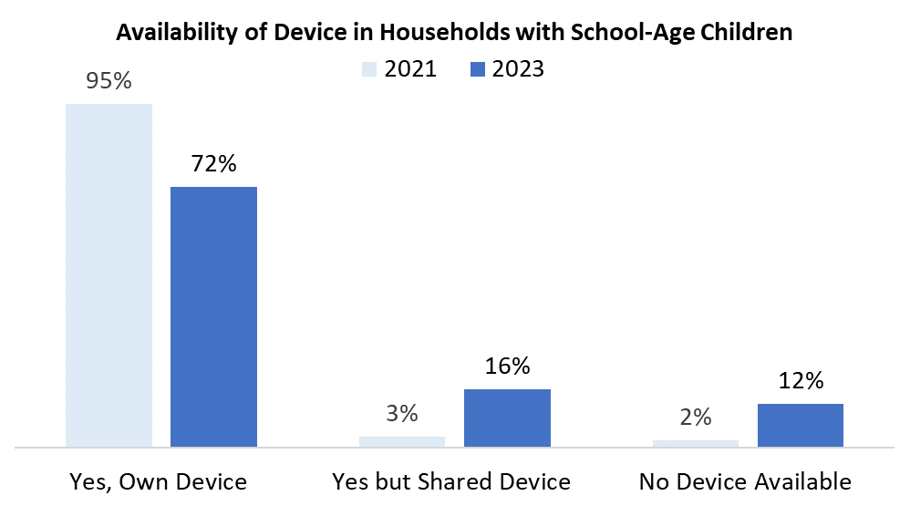
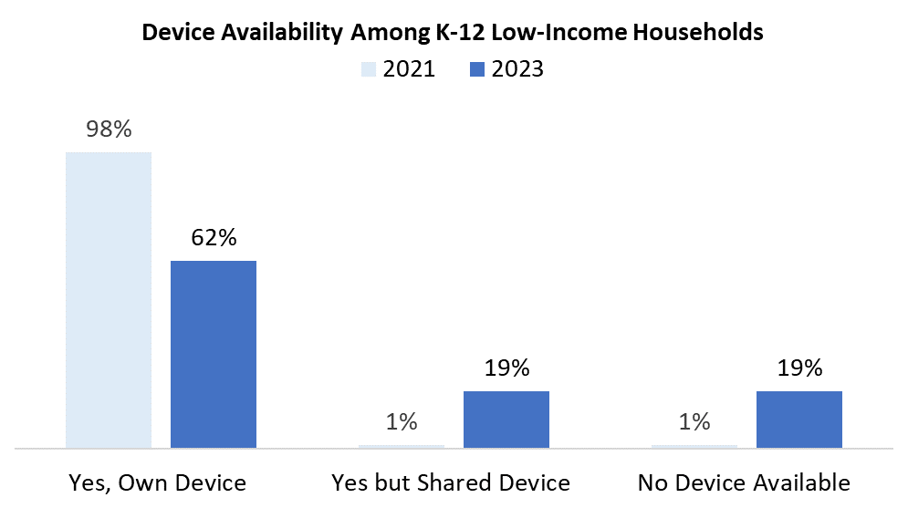
Device Availability Has Also Decreased, in Particular Among Low-Income K-12 Households

Slide 30
Main Topics
Adoption Across Covered Populations and Regions
Broadband Costs
Reasons for Non-Adoption
ACP Awareness and Participation
Telehealth
Access and Devices Among K-12 Households
Digital Skills

Slide 31
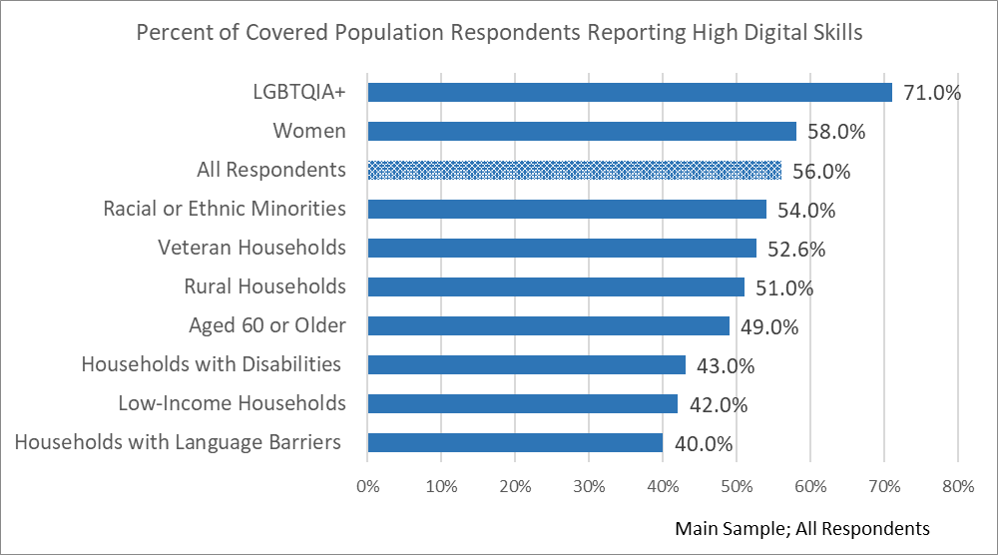
Share of High-Skills Users is Lower Among Non-English-Language HHs, Low-Income HHs, and HHs with Disabilities

Slide 32
THANK YOU
Dr. Hernan Galperin
hernan.galperin@usc.edu
Dr. François Bar
fbar@usc.edu
Dr. Thai V. Le
thaivle@usc.edu
Full 2023 Digital Equity Survey Report:
https://arnicusc.org/2023-statewide-digital-equity-survey/

